Slide 1
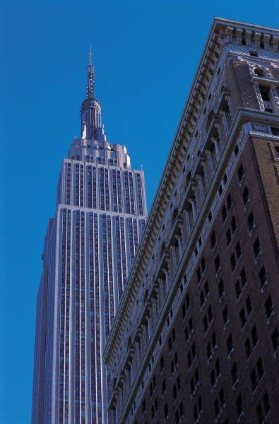
Skyscrapers
Engineering Camp

Slide 2
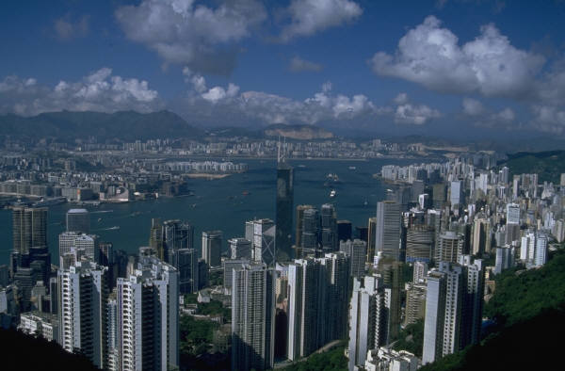
Why Build Skyscrapers?
Space – Available real estate.
Small footprint for maximum use.
Like a ranch house compared to a 2 story
Ego – Competition in construction
Bigger is better
Notoriety Puts a place on the map
Eiffel Tower in Paris
Sears Tower in Chicago
Petronis Towers in Malaysia

Slide 3
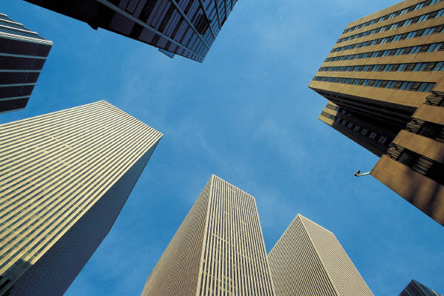
What problems must be overcome?
Construction
Masonry
Steel
Forces
Gravity
Wind Resistance
Other
Accessibility
Safety
Comfort
Aesthetics
Future

Slide 4
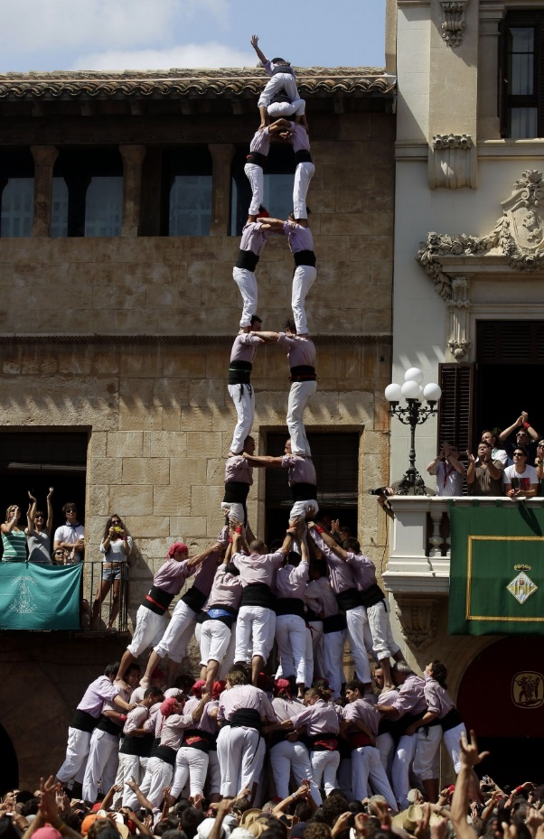
Construction
Building a strong base - foundation

Slide 5
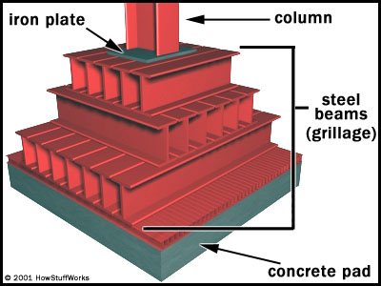
The Modern Substructure Addressing Gravity - Spread the load
This spread footing is a typical substructure. It sits on the hard clay under the ground or bedrock. When complete, the entire structure is covered in concrete.

Slide 6
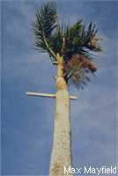
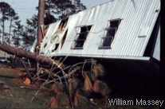
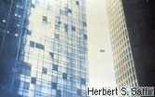
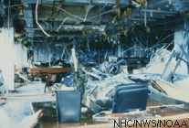
Wind Resistance

Slide 7
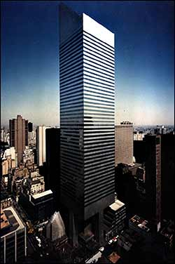
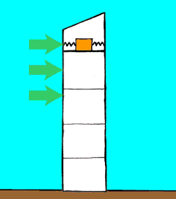
Tuned Mass Damper
A kind of spring that allows the building to move with the wind, but not break or crack.

Slide 8
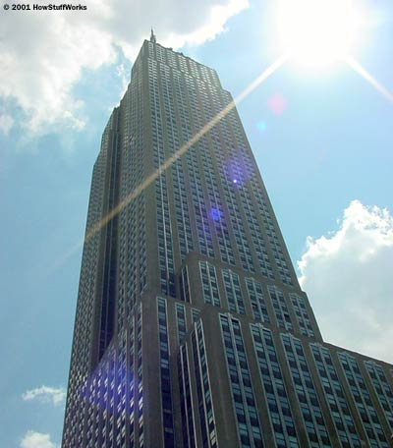
What Goes Up The elevator structure
The Empire State Building's 73 elevators can move 600 to 1,400 feet (183 to 427 meters) per minute. At the maximum speed, you can travel from the lobby to the 80th floor in 45 seconds.
Add more floors – need more elevators
Add more elevators – need more floor space
Need more floor space – why go any further

Slide 9
Building Safety
Fire resistant materials
Sprinkler Systems
Access to exits

Slide 10
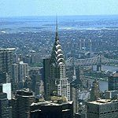
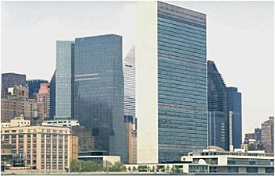
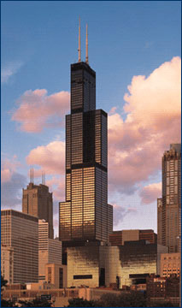
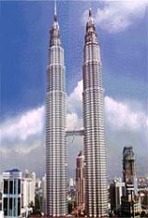
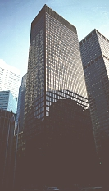
You’ve got to have Style

Slide 11
How High Can it Go?
With existing technology – a mile (5280’)
We need lighter and stronger materials
Elevators must be improved – faster
Sway dampers need to be improved

Slide 12
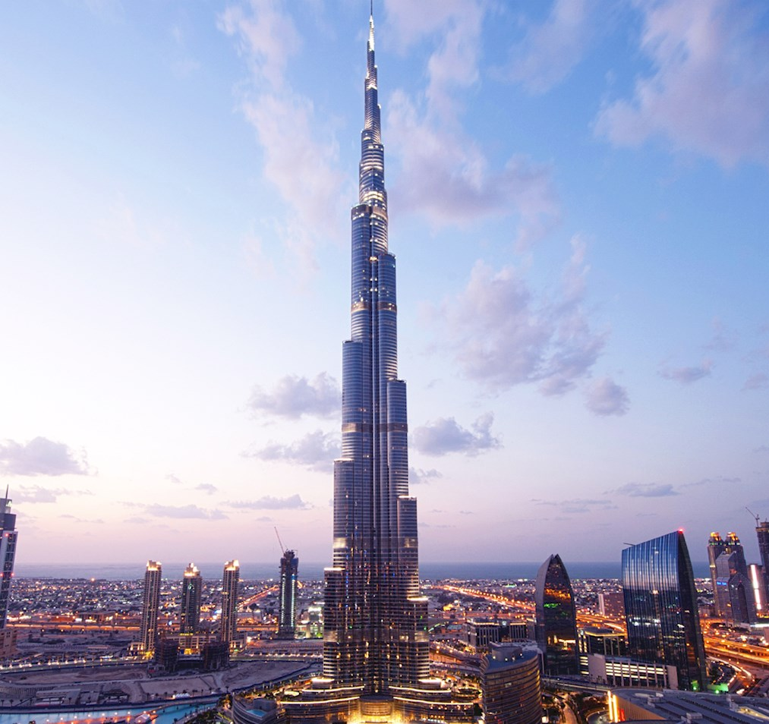
Burj Khalifa – 2717’ tall, 163 floors United Arab Emirates

Slide 13
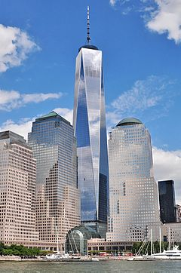
One World Trade Center 1776’ tall, 104 floors United States

