Slide 1
CyberCharged Raspberry Pi – Using the GPIO/Hardware
Ms. Flowers

Slide 2
So…Raspberry Pis
A Raspberry Pi can do most things a “regular” computer can do and it can do things that a “regular” computer cannot do.
You can use the GPIO (general purpose input/output) to control electrical components like light emitting diodes (LEDs) and switches.

Slide 3
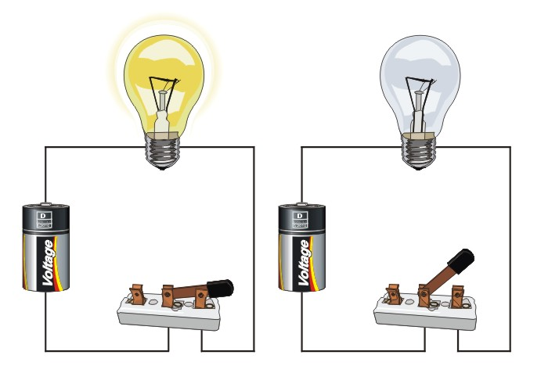
Making circuits (It’s easy)
In the most basic form, a circuit is a closed path in which current flows. Let’s think about something you use all the time – a light bulb.
When the switch is closed, current flows from the battery to light the bulb.
When the switch is opened, current can no longer flow and the light bulb will turn off.
Notes:
For the Raspberry Pi circuits we will make later: the battery is replaced by the power from the raspberry pi and the switch becomes a command in your code.

Slide 4
Hardware?
We will be using:
A breadboard
A T pin breakout board
LEDs (light emitting diodes)
Buttons (a push toggle switch)
Resistors (set voltages and currents in a circuit)
Wires (to make connections)

Slide 5
Breadboard
Not connected
The well in the center electrically divides the board
The power (+) and ground (-) supplies
Electrically connected

Slide 6
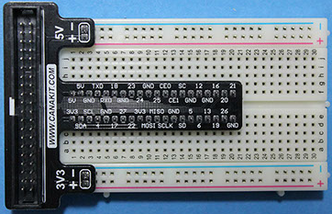
Breakout board with breadboard
Pin numbers (e.g. 4) provide power (like a battery)
GND pin are used to help close the path of a circuit.
We use python to turn a pin “on” or provide power to a pin.

Slide 7
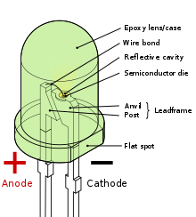
LEDs
LEDs use a special material that can emit like at different colors
They are polarized. This means that they have to be positioned in the circuit in a particular way. One wire is longer than the other. The longer one is the anode.
If you LED is not turning on, you probably have it plugged into the board backwards.

Slide 8
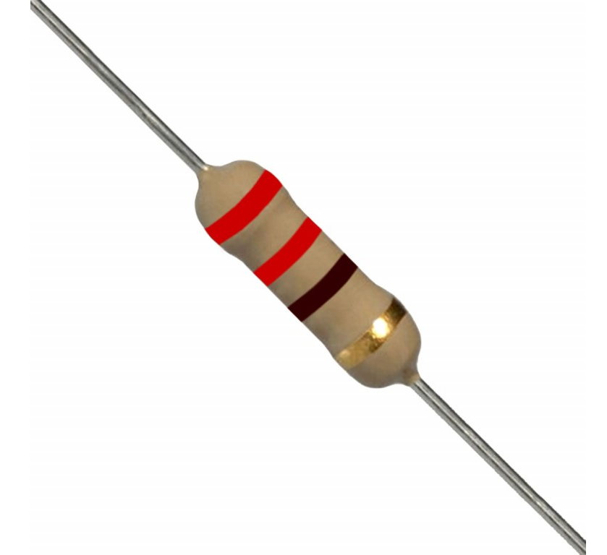
Resistors
We use resistors to control how much current can flow through the LED. Too much current can blow up or break the LED
They are NOT polarized. This means that they DO NOT have to be positioned in the circuit in a particular way.
The colored bands on the resistor tell you the value of the resistor.

Slide 9
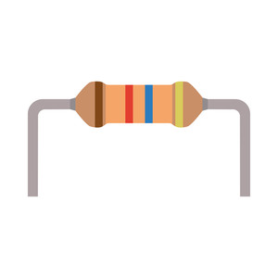
Let’s Build a Circuit.
resistor
GND
Raspberry Pi
Power Pin
&
Switch from your code
LED
Circuit ground
PIN 5
Notes:
All circuits must have a ground connection to work properly. There are several ground pins on the T-connector.
The T connector has multiple pins for power. The number of the pin used needs to be used in your code.

Slide 10
Time to code
Go to Python 3
Open IDLE3
We will start by typing commands in to the command window.
Notes:
Start with writing directly in the command window. We will move to creating a script (or program) in the next example.

Slide 11
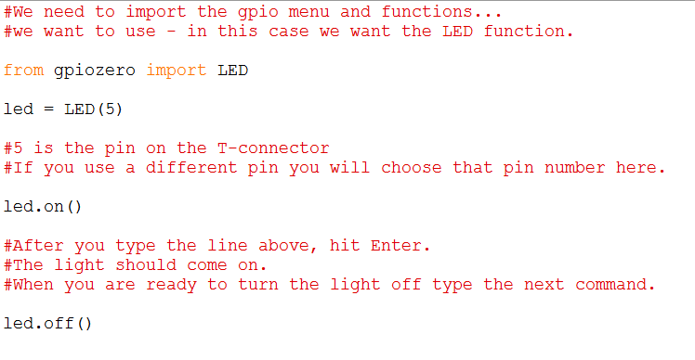
Time to code
Notes:
Have them type the non-red lines into a python

Slide 12
Writing a script
We can do most any coding/analysis by entering commands in the Command Window.
This is tedious and problematic because we have no way of correcting commands easily and we cannot recall numerous lines of commands at one time.
Solution? – Writing python scripts
Go to the IDLE3 and go to File and select New
Notes:
When they select a new file, it opens a simple text document to type their code. Different parts of the code may be in different colors. Example: Comments are in red, text in quotations is green, functions are purple…

Slide 13
Let’s make our light more interesting
Notes:
Type this code into the new file. Save it in the main folder (it should default). Call it light_blink. Python will save it as a .py format
After it’s saved go the run tab and select “Run Module”
The light should blink.
Those that are working faster. Can they change their code to blink more slowly or more quickly? Can they add new lines (within the loop) such their light blinks in a particular pattern? I will give you an example.

Slide 14
Using a button
A button is a simple toggle switch (push once for one action, push again for another action)
Take your button and connect it to your board.
One of the button pins is connected to a Raspberry Pi power pin (pin 4) in this picture
The other pin is connected to the GND pin via the outer bus.
In a new file (just like before) type:
from gpiozero import Button
my_button = Button(4)
my_button.wait_for_press()
print(“You are pushing my button!!”)
Save as button_test
Then run (just like before)
Notes:
For buttons, I like to “straddle” the button across the groove that runs along the center of the board. Note: the buttons are “temperamental”. They require both finesse and force to push into the breadboard.
They can leave the LED circuit on their board. The two circuits will not interfere with each other.
Note: my_button is a variable
When they push the button, the message will print on the screen.

Slide 15
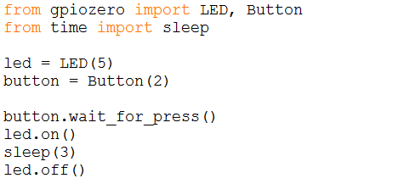
Control the LED with the button
Notes:
Again – new file and save it as something that makes sense like led_button

