Slide 1
Kid Krypto – Public Key Encryption
Keeping Secrets

Slide 2
Encryption
Encryption is the key to information security. And the key to modern encryption is that using only public information, a sender can lock up their message in such a way that it can only be unlocked (privately, of course) by the intended recipient.

Slide 3
It is as though everyone buys a padlock, writes their name on it, and puts them all on the same table for others to use.
They keep the key of course—the padlocks are the kind where you just click them shut.
If I want to send you a secure message, I put it in a box, pick up your padlock, lock the box and send it to you.
Even if it falls into the wrong hands, no-one else can unlock it.
With this scheme there is no need for any prior communication to arrange secret codes.

Slide 4
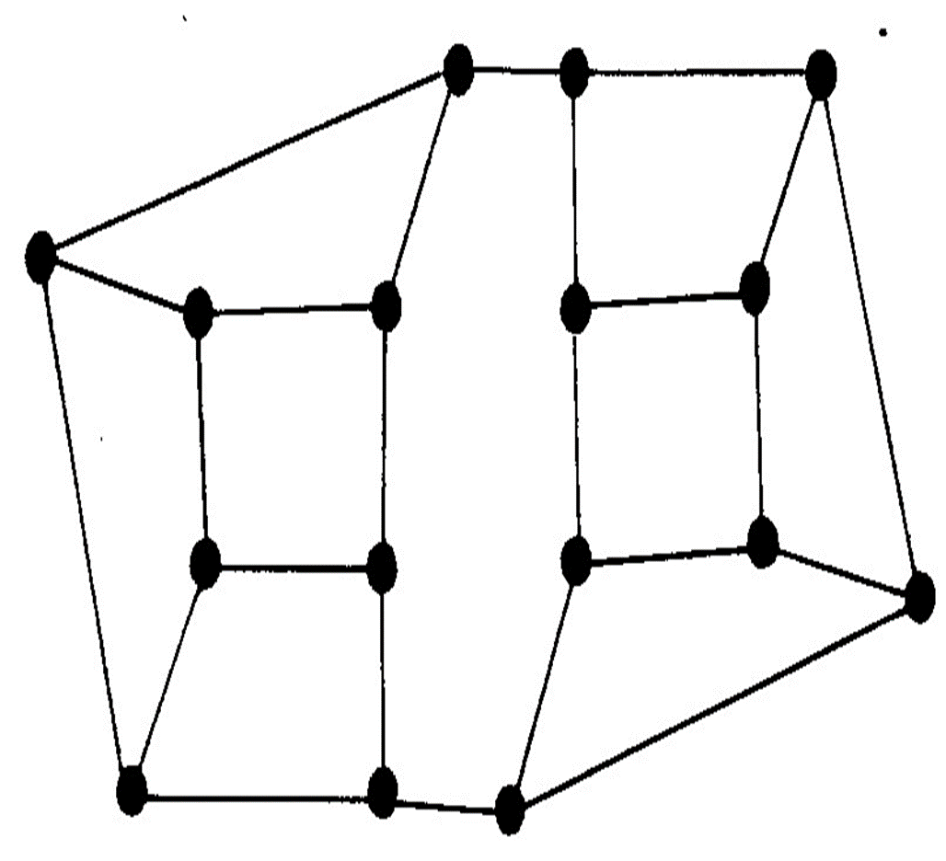

Slide 5
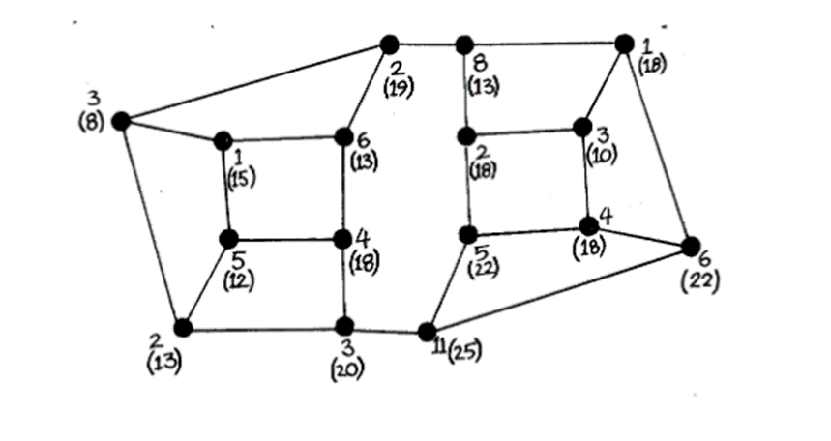
Pick a number to send.
To encrypt the number, place random numbers on each intersection on the map, so that the random numbers add up to the number that you are sending. (Example below)
Here, the number being sent is 66, so all the unbracketed numbers add up to 66.

Slide 6
Now we must calculate what to send. If we sent the map with the numbers on, that would be no good, because if it fell into the wrong hands anybody could add them up and get the message.
Choose any intersection. Look at it and its three neighbors—four intersections in all—and total the numbers on them. Write this number at the intersection in parentheses or using a different color of pen. For example, the rightmost intersection in the figure is connected to three others, labeled 1, 4, 11, and is itself labeled 6. Thus it has a total of 22. Now repeat this for all the other intersections in the map. This should give you the number in parentheses in the figure.
The map will be sent with only the parenthesized numbers on it.

Slide 7
Erase the original numbers and the counts, leaving only the numbers in parentheses, or write out a new map with just those numbers on it. See if any of the students can find a way to tell from this what the original message was. They won’t be able to.
To decode the message you need the private map with its private key.

Slide 8
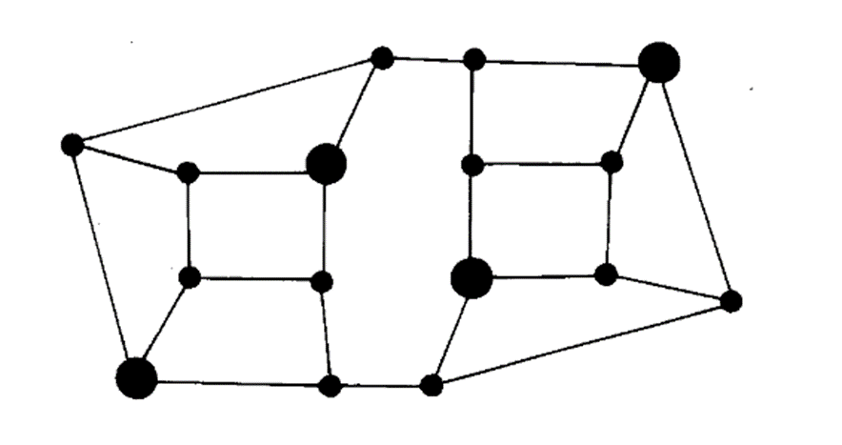
On the coded message mark the special enlarged nodes on the private map (Figure below).
To decode the message, look at just the secret marked intersections and add up the numbers on them. In the example, these intersections are labeled 13, 13, 22, 18, which add up to 66, the original message.

Slide 9
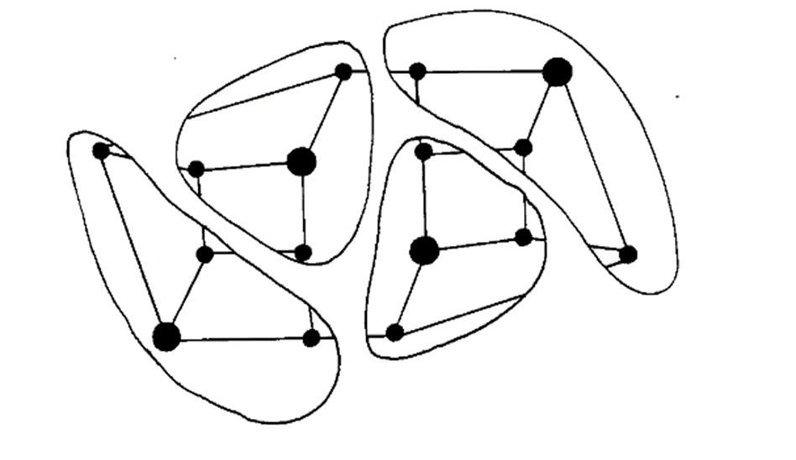
How does it work?
Choose one of the marked intersections and draw around the intersections one street distant from it, and repeat the procedure for each marked intersection. This will partition the map into non-overlapping pieces, as illustrated in the figure below.

Slide 10
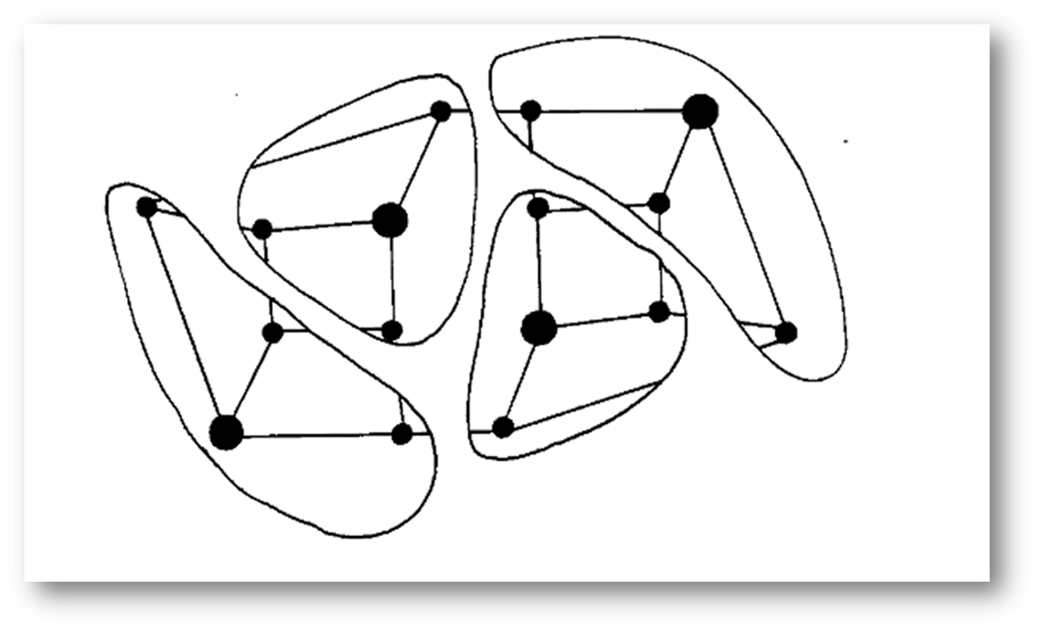
The group of intersections in each partition is exactly the ones summed to give the transmitted numbers for the marked intersections, so the sum of the four transmitted numbers on those intersections will be the sum of all the original numbers in the original map; that is, it will be the original message

Slide 11
Time for you to try it!

